Slide 1

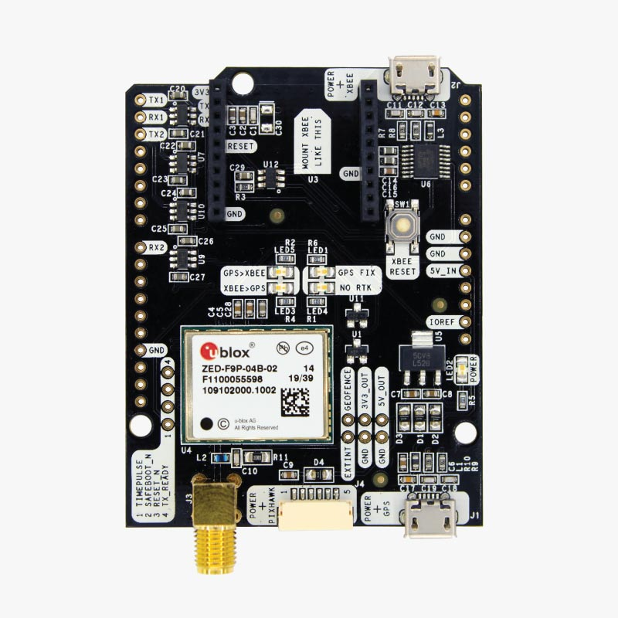
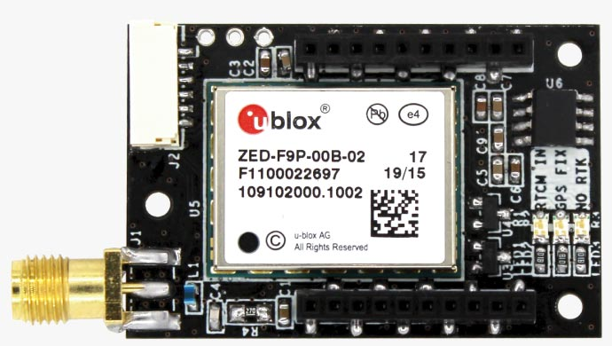
GNSS: Ublox setup
Basic concepts and documentation for the Ublox GNSS receivers, for dual heading, with the boards:
ArduSimpleRTK2B-Budget
ArduSimpleRTK2B-Lite
Ignasi Mallén (ignasi99@gmail.com)
16/07/2024

Slide 2
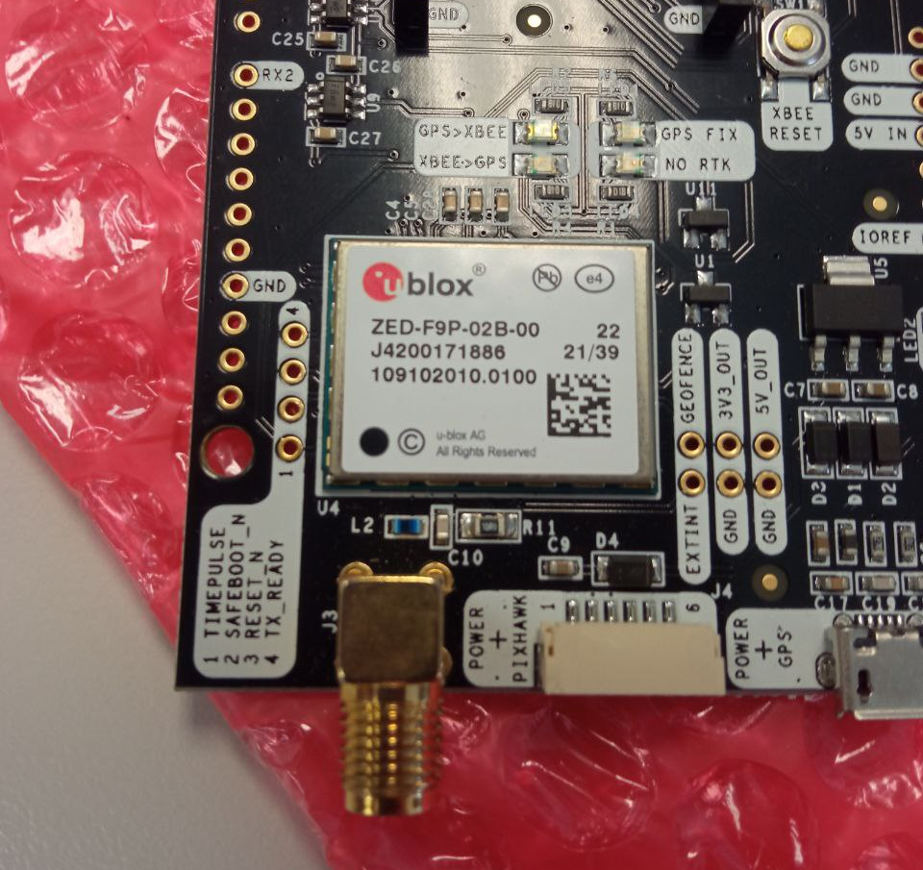
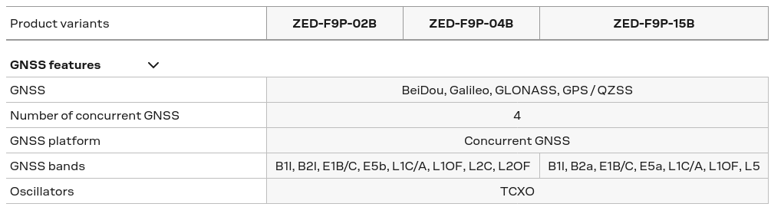
Ublox Module
ArduSimple products:
simpleRTK2B Lite
simpleRTK2B Budget
They provide their own board design with the Ublox module embedded.
Ublox module: ZED-F9P, there are three types (I think ArduSimple products have either the 02B or the 04B)
Difference between them are the RF bands!!

Slide 3
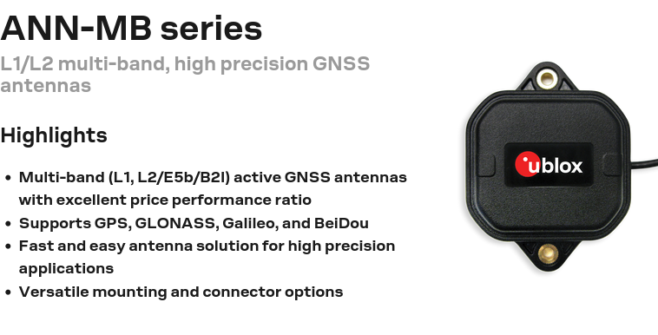
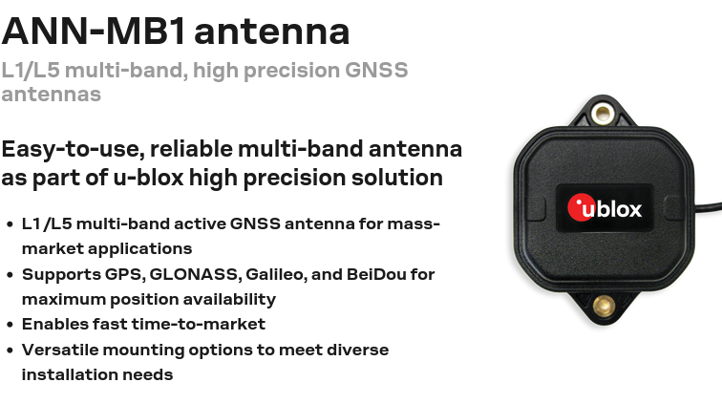
Antennas
There are 2 types of antennas that may be confusing!
Depending on the Ublox module, it will be one on another.
INVENTORY:
We bought 2 ANN-MB1 but then we realized that they were useless for our modules, so we still have them in the workshop of CDEI.

Slide 4
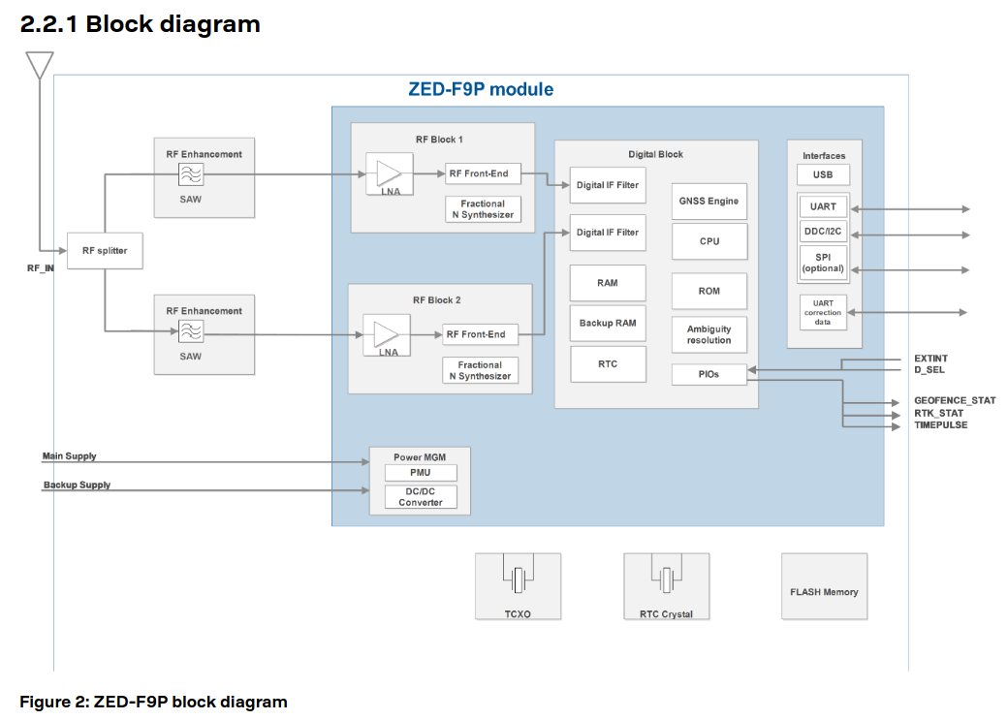
ZED-F9P
4 interfaces (input/output) available:
UART1
I2C
SPI
UART2
Dual band (L1/L2)
Where the configuration can be permanently saved

Slide 5
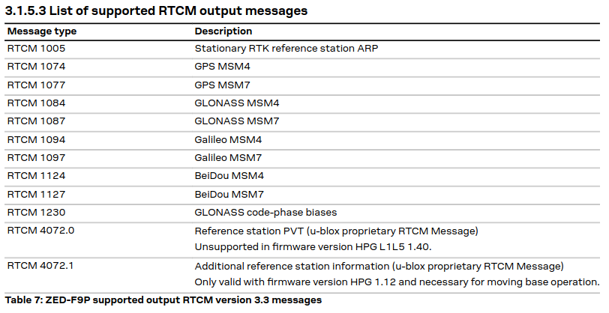
RTCM corrections
*Since it is binary, it is not possible to interpret the messages (not like NMEA messages, which can be directly interpreted).
How does it work? Have a look at the ZED-F9P Integration Manual
RTCM is a standard-based binary* protocol for the communication of GNSS correction information.
The ZED-F9P receiver supports RTCM version 3.3 (RTCM3).
The receiver can RECEIVE and/or SEND corrections.
List of RTCM that can be generated and sent from a ZED-F9P
Information for stationary base station for RTK
Corrections regarding GNSS constellations
Information for moving base station for RTK
Not used for our module

Slide 6
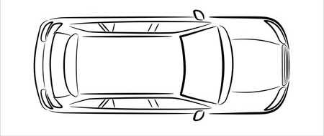
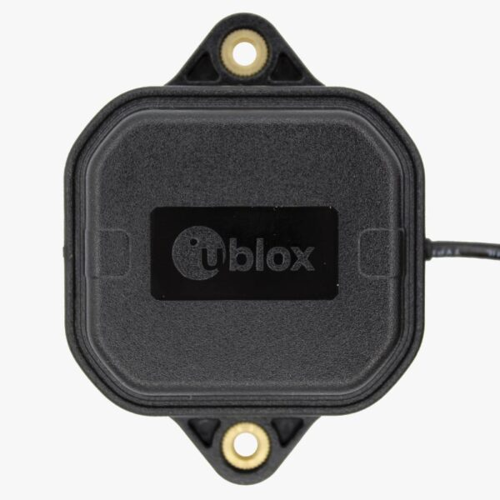
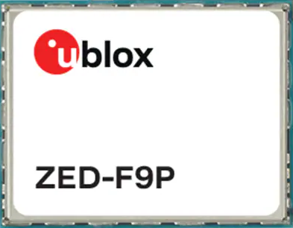
Moving Base (MB) operation: Dual heading
From Integration Manual:
3.1.5.6 Base and rover configuration for moving base RTK operation
The moving base (MB) mode differs from the standard RTK operation in that the base station is no longer stationary at a predetermined location. Both the reference station and rover receivers are allowed to move while computing an accurate vector between the receiver antennas. This mode enables the calculation of heading on dynamic or static platforms.
MB
Base sends corrections to Rover.
Rover calculates vector and its heading (with respect to the north).
Vector is calculated from Rover to Base.
Vector is expressed in NED (North-East-Down) frame. NOT IN THE ANTENNA FRAME!!!
The antennas should be placed such that the vector is pointing the X-axis forward of the robot (base_link or turret_link)
North
MB Rover
MB Base

Slide 7
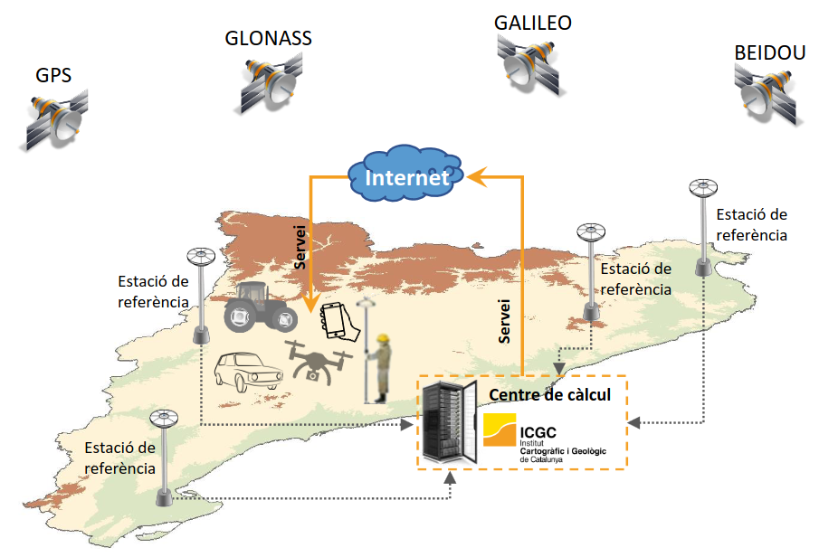
NTRIP corrections
In Catalonia we have the ICGC public service. We need a free account:
User: ignasiCDEI
Password: cdei2023
NTRIP stands for Networked Transport of RTCM via Internet Protocol.
External corrections are used to improve position accuracy to cm level.
The robot needs internet connection to receive corrections from the NTRIP Caster.
The NTRIP Caster needs the location of the GNSS receiver to calculate proper corrections.
This location is sent in format of NMEA Sentence, which is a string of ASCII characters.
Example of NMEA: $GNGGA,103506.40,4124.19332,N,00208.90642,E,1,12,0.70,101.5,M,49.3,M,,*42
IP: catnet-ip.icgc.cat
Port: 2101
Mountpoint: VRS3M
ROS
All data →
← RTCM
Driver
NMEA →
← RTCM
NTRIP Client
NMEA →
← NTRIP
NTRIP Caster (ICGC)
Serial
Internet

Slide 8
Overall SETUP
Two instances of the same driver
Two serial USB connections to ArduSimple Boards
Connection between Ublox modules is done attaching the two boards
ArduSimple Boards
ROS
Base
NMEA →
← RTCM
Driver_1
(base)
NMEA →
← RTCM
NTRIP Client
NMEA →
← NTRIP
NTRIP Caster (ICGC)
↓RTCM
Rover
All data →
Driver_2
(rover)
NavSatFix, Velocity, Heading, ….
Serials
Internet

Slide 9
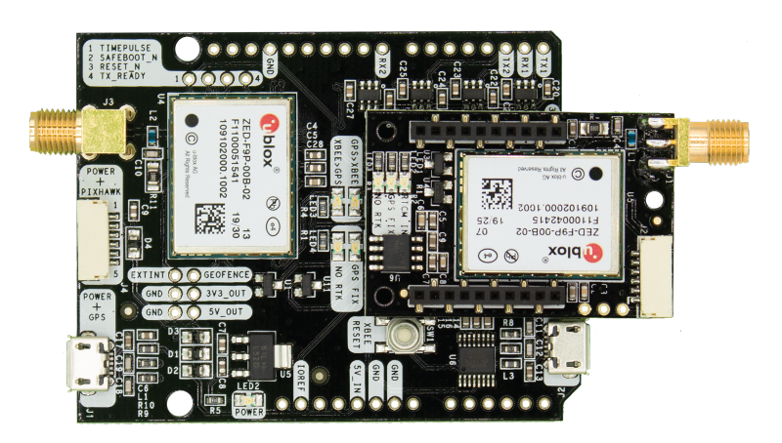
Physical connections
This bus connection transport all these messages:
RTCM from NTRIP (from serial USB)
RTCM from Base
NMEA from Base
And they are broadcasted (no destination specified). Then, it is going to be necessary to apply the following filters:
Filter RTCM from Base in Driver_1
Filter RTCM from NTRIP in Rover
Rover
Some notes:
Rover must read RTCM from Base, not from NTRIP, that is why Rover needs to filter RTCM from NTRIP.
NMEA from Base are not read in Rover by default, so no additional filter is needed.
UART2
Base
UART1
UART1
Driver_2
(rover)
Serial USB for Base
Serial USB for Rover
Driver_1
(base)

Slide 10
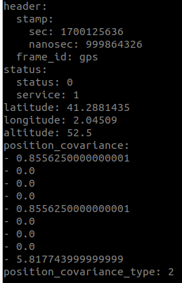
Status of GNSS solutions
Example of ROS NavSatFix msg:
-1 → No solution found: Solution not reliable
0 → Fix: No corrections applied (m accuracy)
1 → RTK Float: Corrections applied, but no definitive solution (dm accuracy)
2 → RTK Fix: Corrections applied and definitive solution found (cm accuracy)
The status can also be checked with the board’s LEDs:
 | -1 | 0 | 1 | 2
GPS FIX | Off | Blinking | Blinking | Blinking
NO RTK | On | On | Blinking | Off

Slide 11
Combinated Status Solution for Rover and Base
Base | Rover | Heading | Position | Notes | What to do?
x | -1 | No solution | No solution | Cold start-up or something is not working: no signal. | Check antennas (connection/skyview).
x | 0 | Not calculated | Meters | Rover is not receiving corrections from base. | Check base, check configuration.
0 | 1 | Calculated but not reliable | Meters | Base doesn’t receive NTRIP. Heading is being calculated. | Wait few minutes. Ensure good skyview.
0 | 2 | Calculated and reliable | Meters | Best performance without Internet. | Check Internet connectivity.
1 | 1 | Calculated but not reliable | dm | Both base and rover seem to be calculating better solution. | Wait few minutes. Ensure good skyview.
1 | 2 | Calculated and reliable | dm | Base do not achieve RTK fix solution, but rover do. | Wait few minutes. Ensure good skyview.
2 | 1 | Calculated but not reliable | cm (Best) | Rover do not achieve RTK fix solution, but base do. | Wait few minutes. Ensure good skyview.
2 | 2 | Calculated and reliable | cm (Best) | Best case. | Enjoy!

Slide 12
Setting Ublox configuration with U-Center: Base
Download and install both U-Center and U-Center2: https://www.u-blox.com/en/product/u-center
U-Center: better for testing and check how it works, it also provides an NTRIP Client.
U-Center2: better for configuration, more intuitive and friendly. Less tools (no NTRIP Client).
Base configuration:
Disable QZSS
Disable SBAS
UART1: 460800 kbps
Navigation rate: 200ms (5Hz)
Set NMEA GGA to 0.5Hz
Disable NMEA GLL
Disable NMEA GSA
Disable NMEA GSV
Disable NMEA RMC
Disable NMEA VTG
Enable RTCM 1077 (GPS)
Enable RTCM 1087 (GLONASS)
Enable RTCM 1097 (Galileo)
Enable RTCM 1127 (BeiDou)
Enable RTCM 1230 (GLONASS Code-Phase)
Enable RTCM 4072.0 (Ref. Station PVT)
Set Ref. Station ID of RTCM msgs: 10 (for example)
Not useful constellations.
Transmission rate for this serial bus
The GNSS solution is going to be calculated and published at 5 Hz.
Only a single positioning NMEA (the GGA) once every 2 seconds is enough for the NTRIP Caster. We can disable the others that are predetermined.
We send all the relevant RTCM messages that we can (go back to slide 5). We send MSM7 because it is an improved version of MSM4.
This ID is going to be used by the Rover to filter RTCM messages.

Slide 13
Setting Ublox configuration with U-Center: Rover
Actually, you can set the bus data rates as you want (>=115200kbps recommended), but they must be compatible between them.
Rover configuration:
Disable QZSS
Disable SBAS
UART1: 115200 kbps
UART2: 460800 kbps
Navigation rate: 200ms (5Hz)
Disable NMEA GGA
Disable NMEA GLL
Disable NMEA GSA
Disable NMEA GSV
Disable NMEA RMC
Disable NMEA VTG
Enable UBX-NAV: PVT
Enable UBX-NAV: COV
Enable UBX-NAV: RELPOSNED
RTCM-IN: 10
RTCM-Filter: Strict
Not useful constellations.
Transmission rate for the serial bus that is connected to Driver_2 via USB
Transmission rate for the serial bus that is connected to Base
The GNSS solution is going to be calculated and published at 5 Hz.
We do not need NMEA in Rover, so we can disable all of them.
These are some of the most relevant navigation messages.
The RTCM filter. Set the ID the same as the one set in the Base.

Slide 14
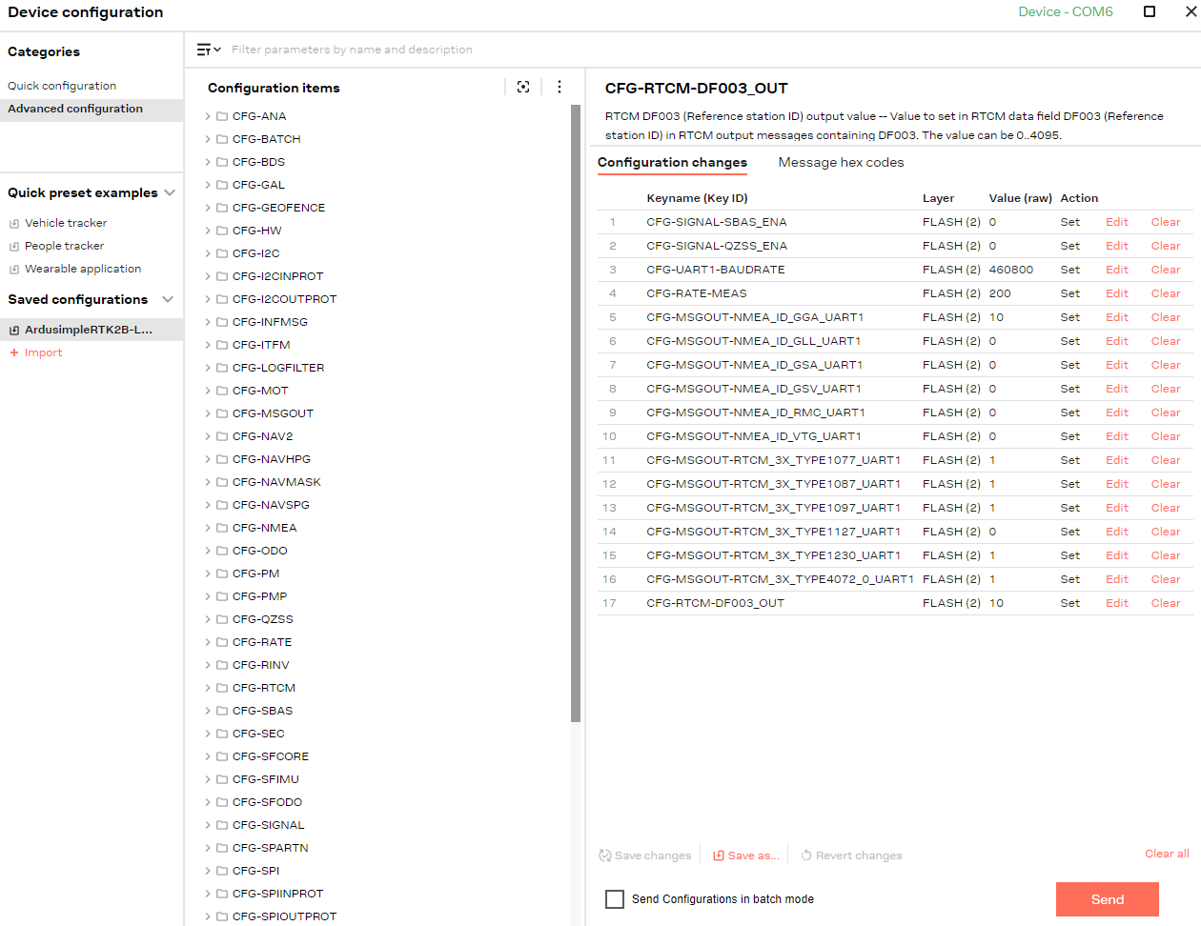
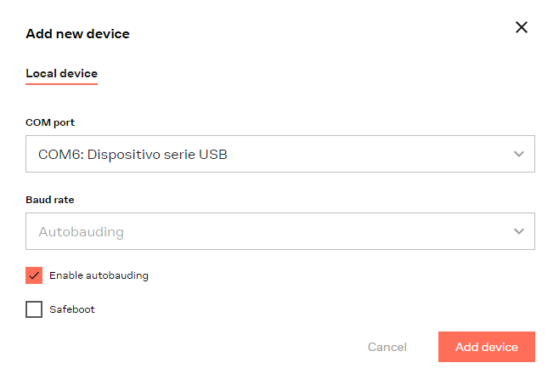
U-Center2 Tutorial: Loading config file
Connecting to Rover
Connecting to Base
Open U-Center2 and connect device.
Add new device with autobauding, or set manually the baudrate (115200 or 460800) if it does not detect it.
Click on “Device configuration”.
In Saved Configurations, import our files.
Check that all the configuration changes are the same as the slides 12 for Base or 13 for Rover and click on “Send”.
If everything OK, the configuration will have been saved in Flash memory (permanent).
You can unplug the receiver and next time you power it on, the configuration will be loaded in RAM.

Slide 15
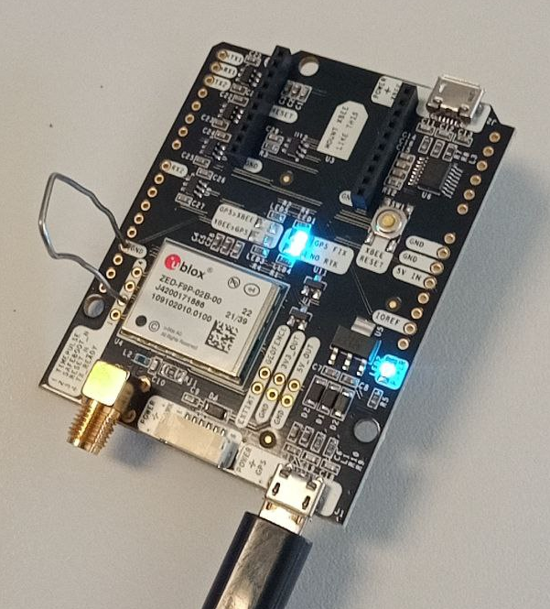
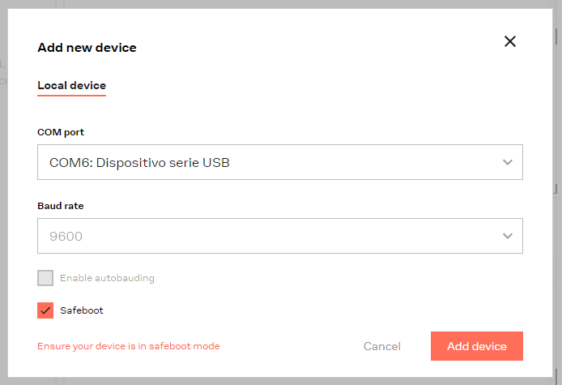
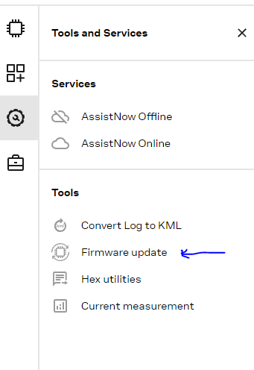
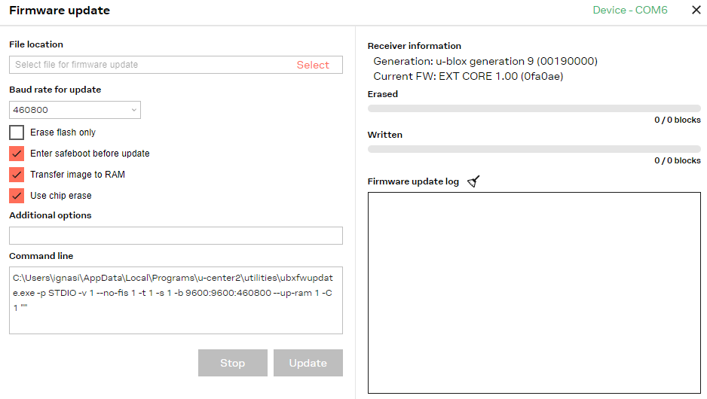
U-Center2 Tutorial: Safeboot reset (Factory reset)
Have you messed it up? Reset it to factory!
Probably you need to connect GND to SAFEBOOT_N pin first.
(Not sure)
1. Open device with safeboot mode
2. Open the Firmware update window.
3. Find a Firmware file from Internet for your Ublox ZED-F9P, download it, set the file location and click on “Update”.
I am not 100% sure about all these steps, so keep trying things until it work! :)
(It worked for me a couple of times, but I do not remember the steps accurately)

